Slide 1
barter boutique trade and collect with the world
BID Spring 2011 | Web Experience
Paul Caravelli
Tawanna Dillahunt
Nicole Fernandez
Ray Luong
Notes:
Good morning everyone, I’m Tawanna, this is Paul, Nicole, and Ray and we are team Barter Botique. Today, we will present to you a
Bartering website designed for collectors of various items such as comics, stamps, coins.

Slide 2
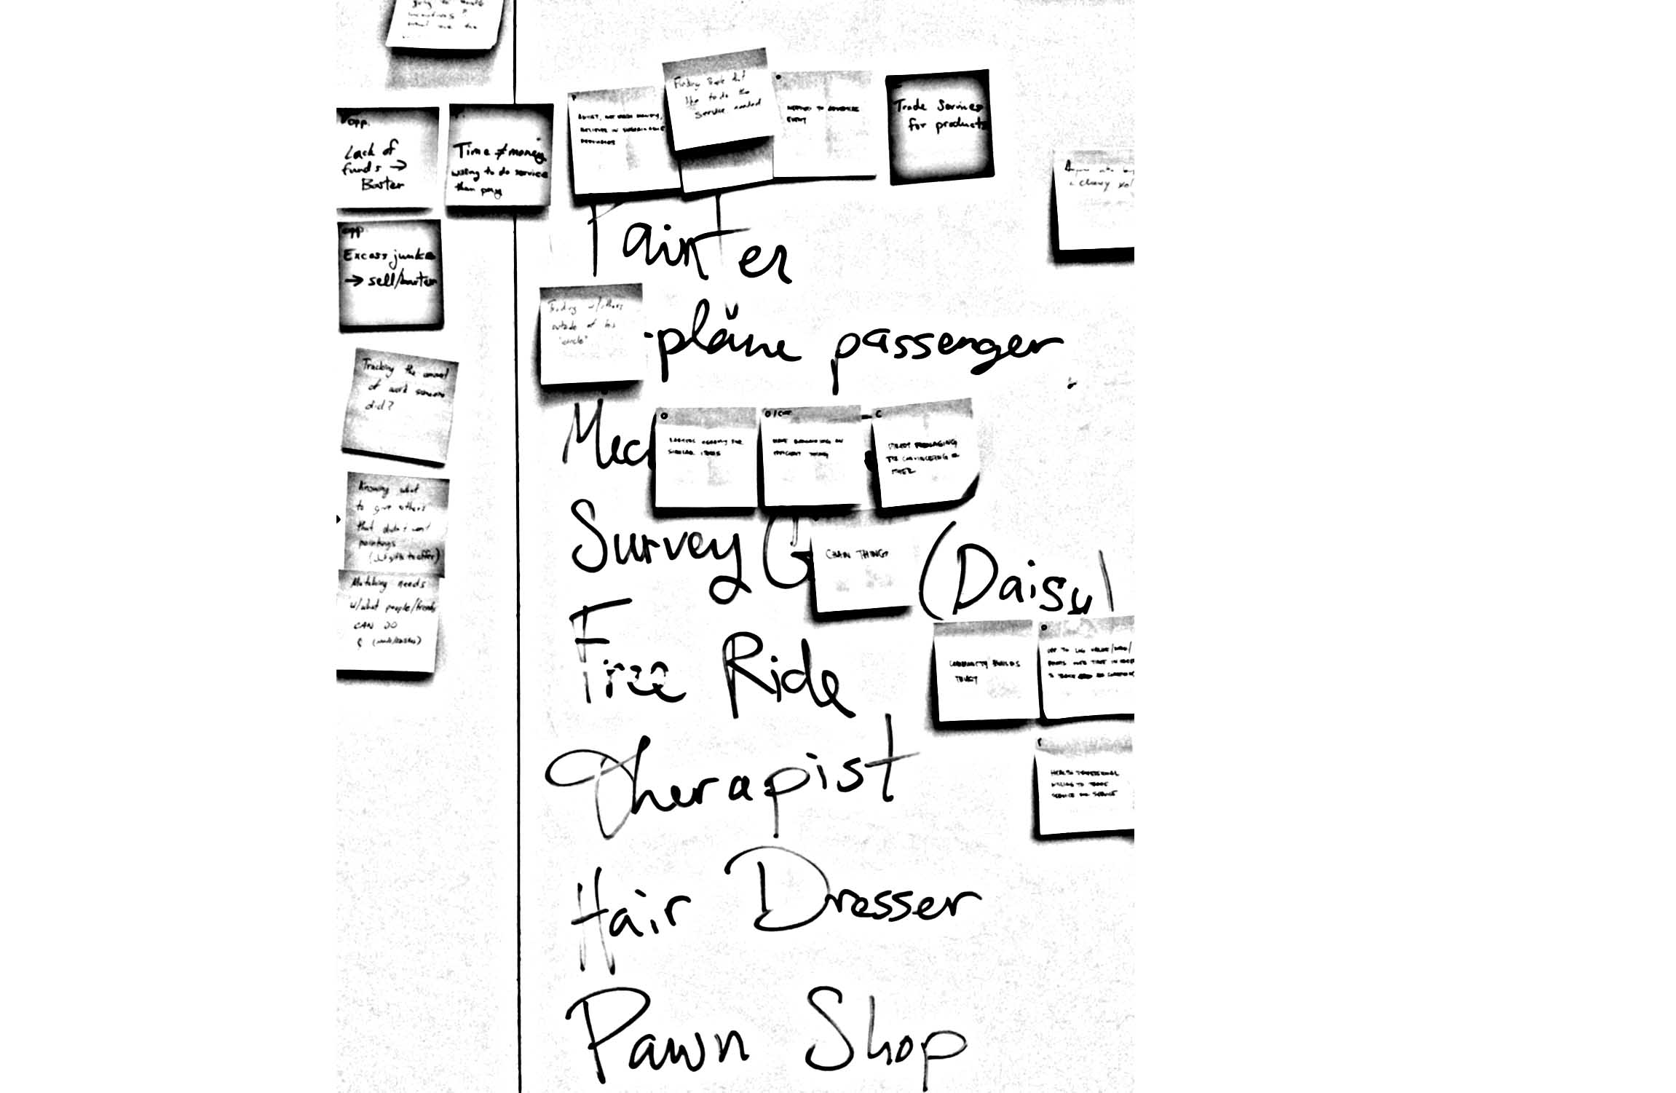
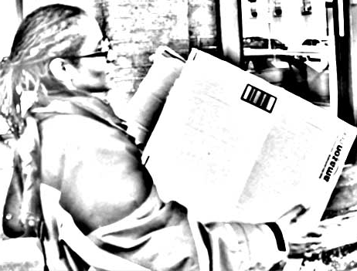
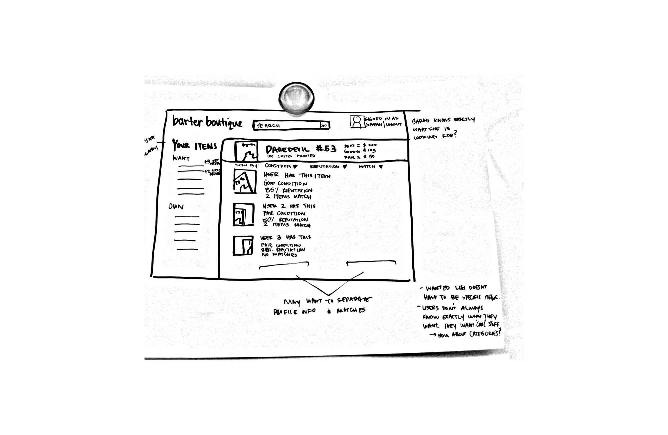
Process
Brainstorming
User needs
Synthesizing
Design
Notes:
Nicole and I will be presenting our process and results and Paul and Ray will demo our site.

Slide 3
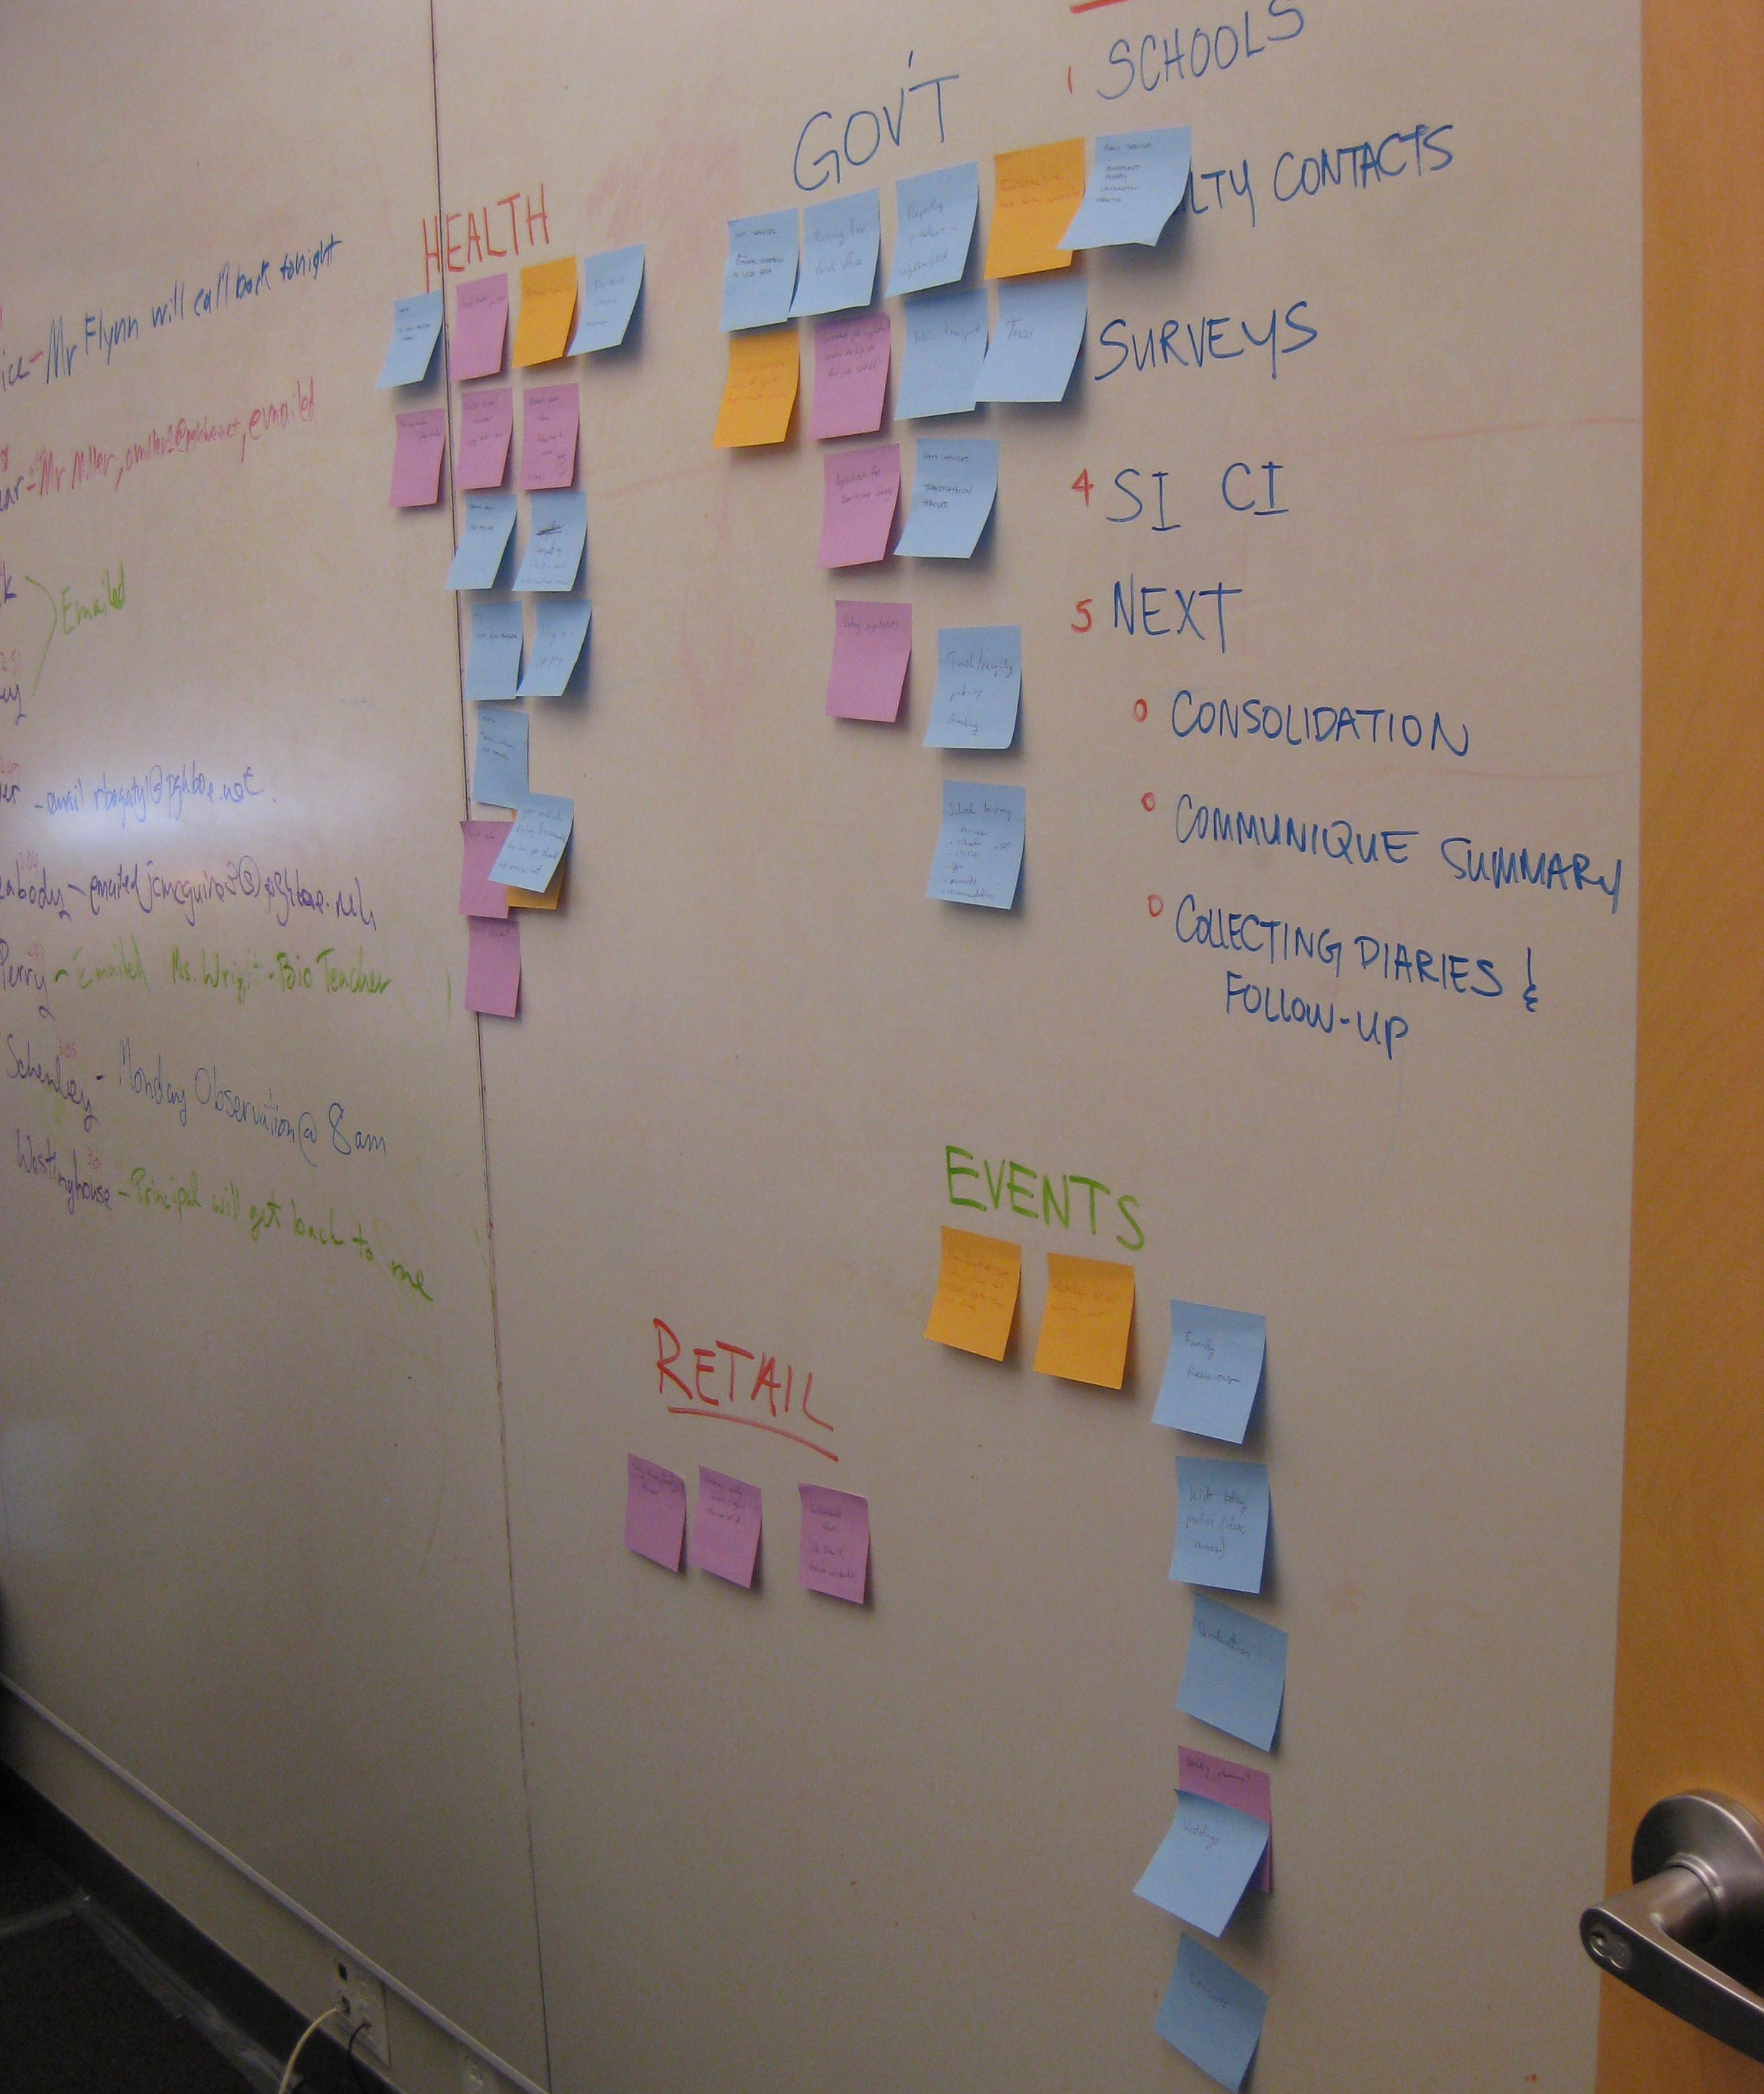
User Needs
Notes:
I’ll start off by describing part of our user research process and will discuss the results of our directed interviews and competitive evaluation. Nicole will
Finish our user research by discussing our brick and mortar and our design.

Slide 4
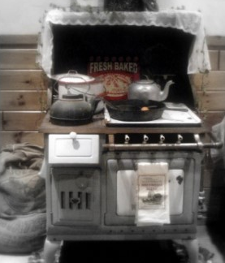

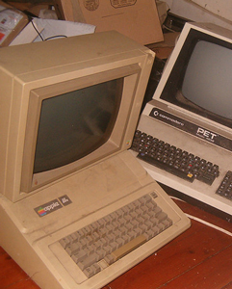
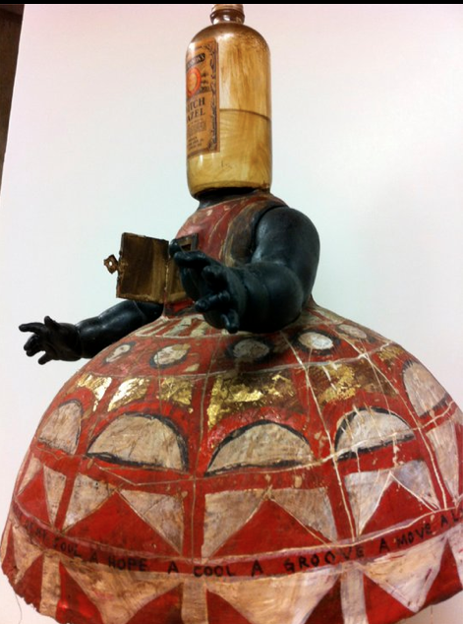
Directed Storytelling
Mechanical Turk
Interviews
Notes:
We conducted interviews and published a hit on mechanical turk to understand people’s bartering experiences.

Slide 5
Directed Storytelling Results
 | Interviews | Mechanical Turk
Typically barter with friends (trust is key) | X | X
Serendipitous trading/repurposing on an auction site |  | X
Trade for services | X | X
Trade similar items (games for games) |  | X
Negotiations may take time (e.g., weeks, months, etc.) | X | X
Notes:
We found that (read slide)

Slide 6
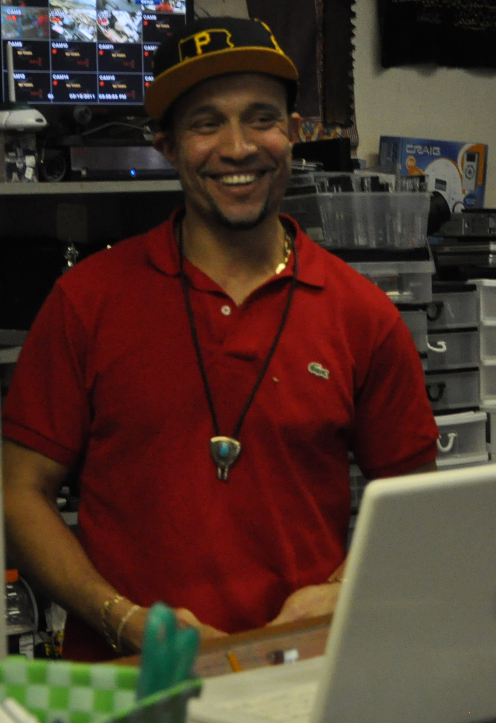
User Feelings
"He got one of my semi-good bikes and I got some of his video games. I felt very good after the trade.” - MT1
"I was thrilled after I had made my first barter. From them on I have been hooked!” - MT2
"After I traded my object and received the new phone I felt over the moon! I achieved getting the handset…whilst cutting out the middle steps…”- MT3
Notes:
Emotionally, individuals recounted positive experiences bartering….

Slide 7
Competitive Evaluation
 | Craigslist Barter | Caveman Trading | TradeBank | BarterQuest
Community among traders |  |  | X | X
Aids in the process of trading |  |  | X | X
Reputation |  |  |  | X
Ability to track trade status
Organized goods | X | X | X | X
Targets individuals | X |  |  | X
Allows for discussion |  |  |  | X
Multiswap
Notes:
Next, we searched for bartering sites that matched our users’ experiences. The four sites listed are a subset of several
Sites found – as you can see, there are three key experiences missing from the sites: the ability to associate reputation with the pers other person in the transaction, the ability to track trade status, and the ability to multiswap.

Slide 8
Brick & Mortar Observations
Notes:
After hearing about user’s experiences, we next conducted brick and mortar observations to see for ourselves how the bartering process went down. Nicole will discuss this next.

Slide 9
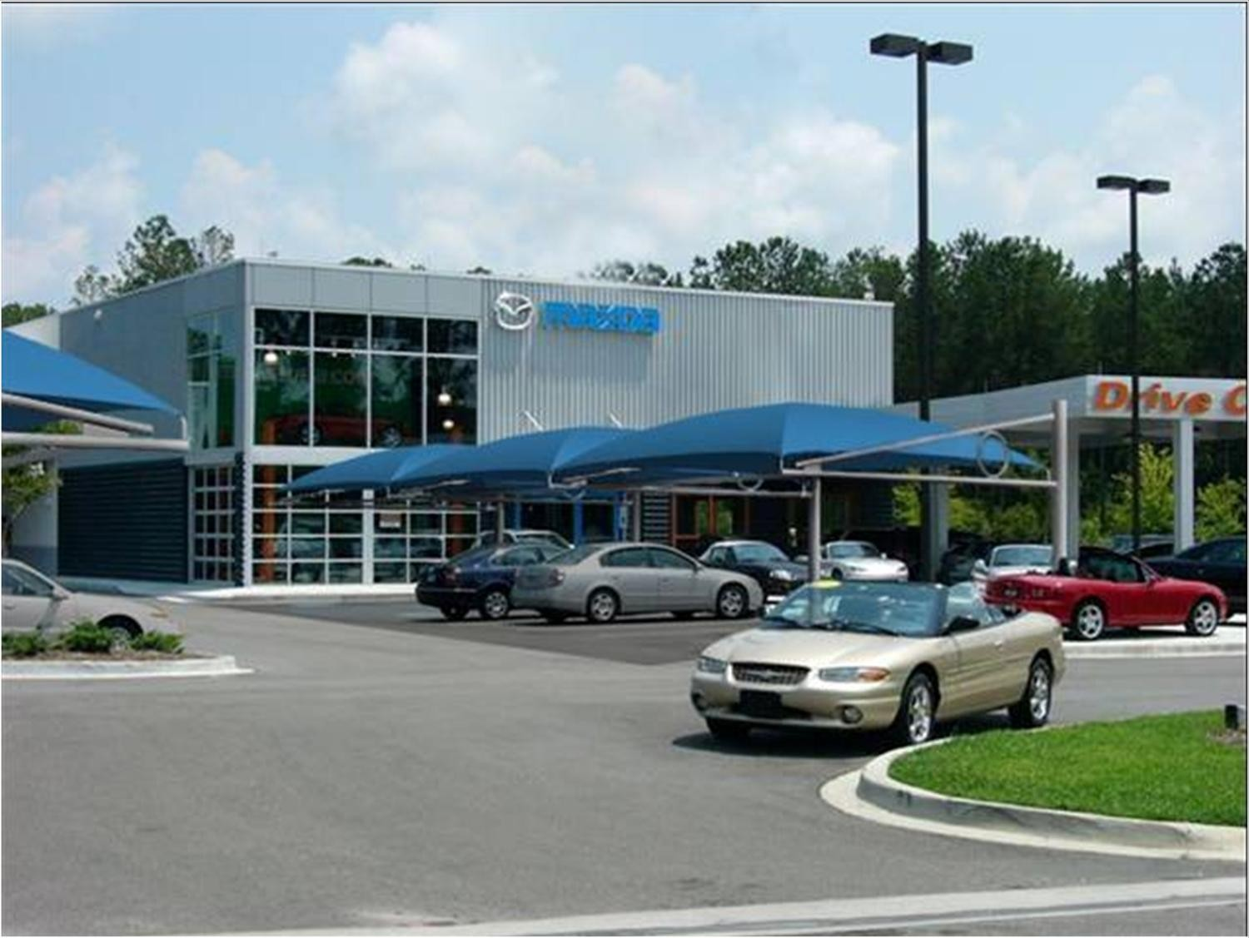
Car Dealership

Slide 10
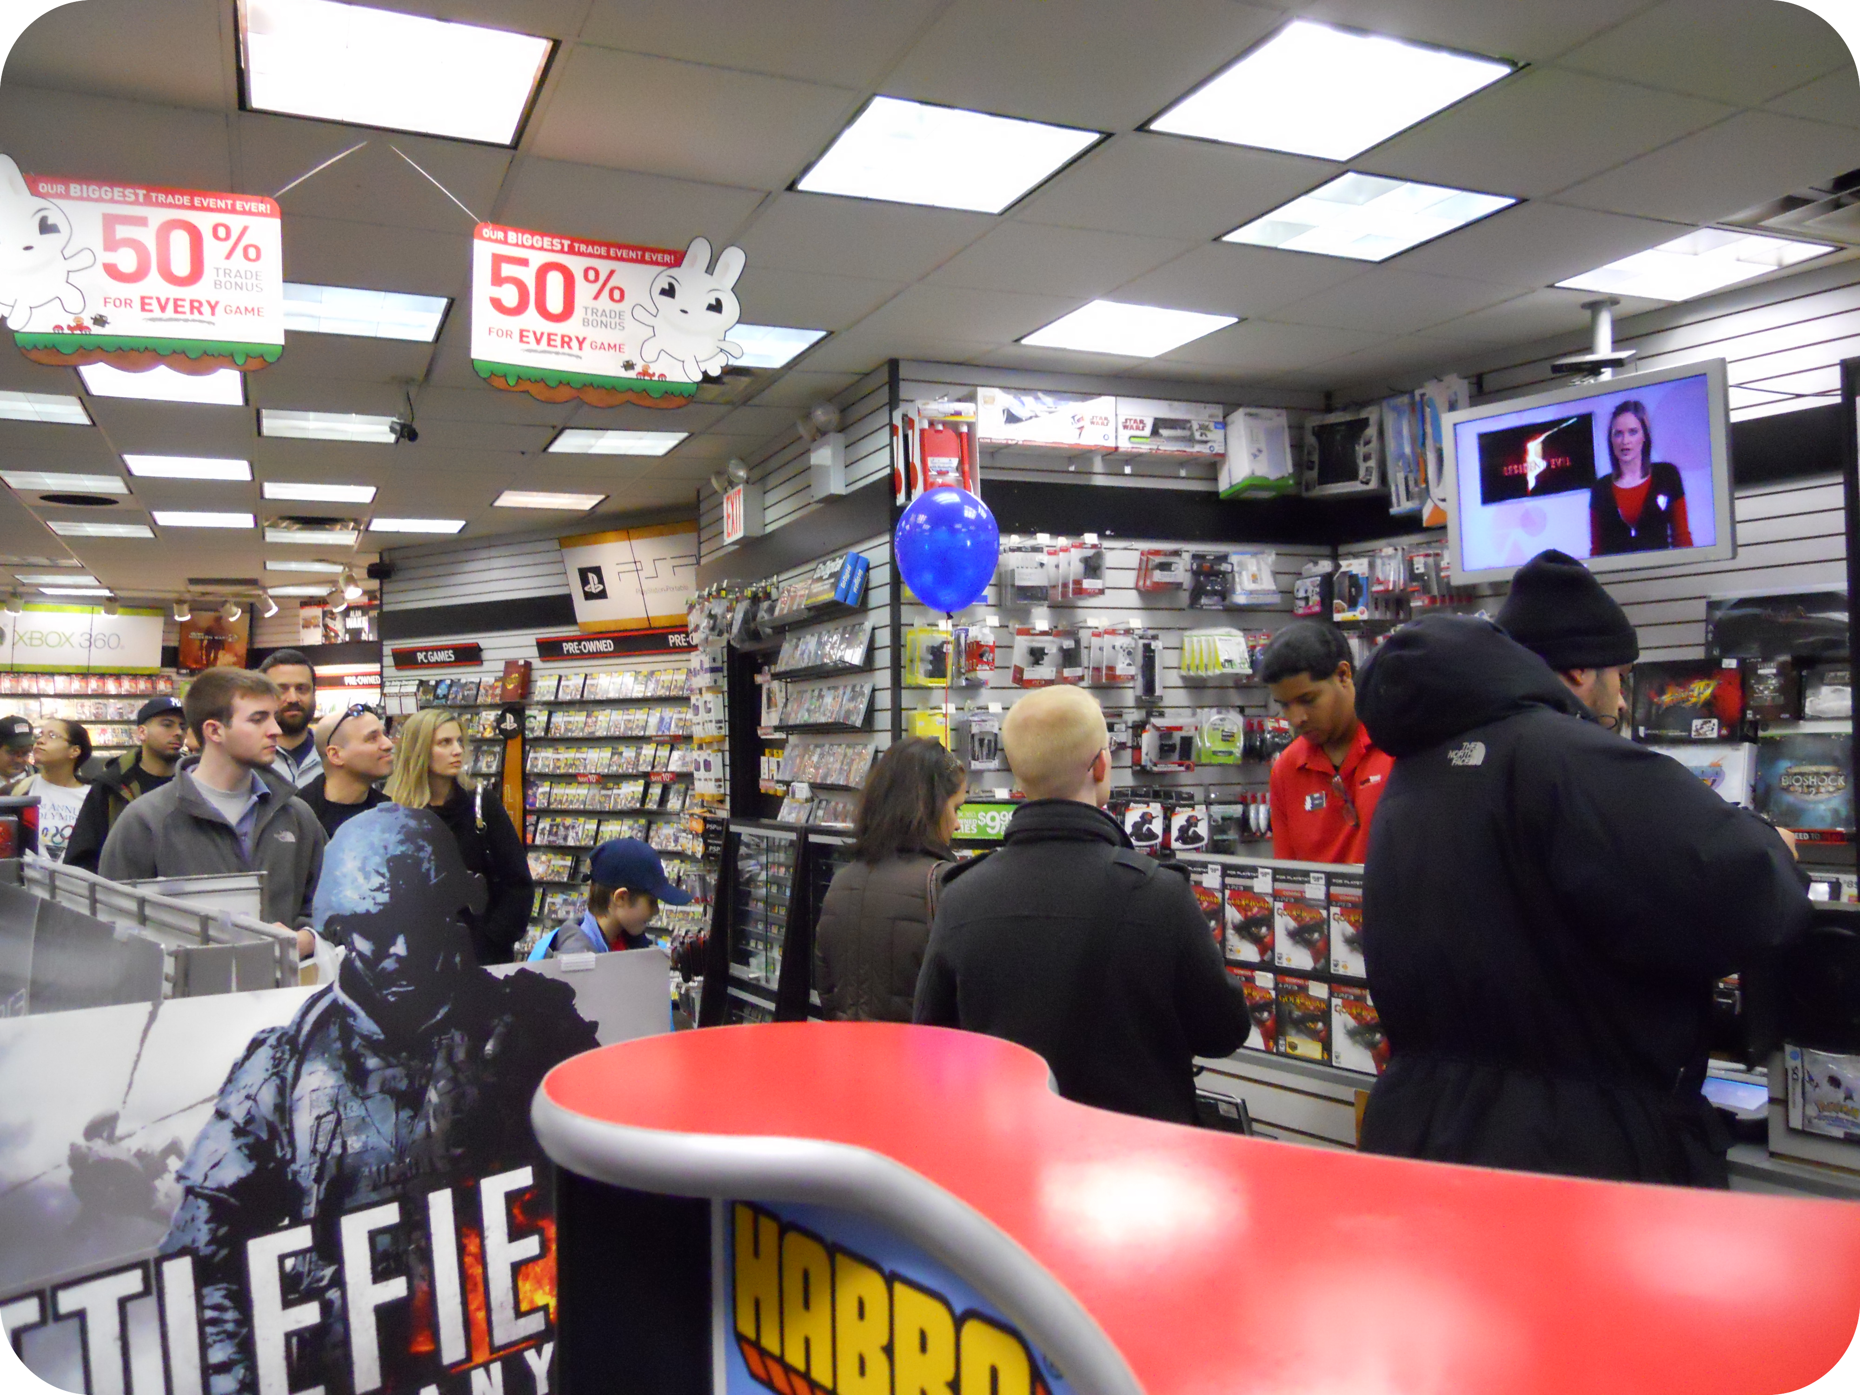
Game Stop

Slide 11
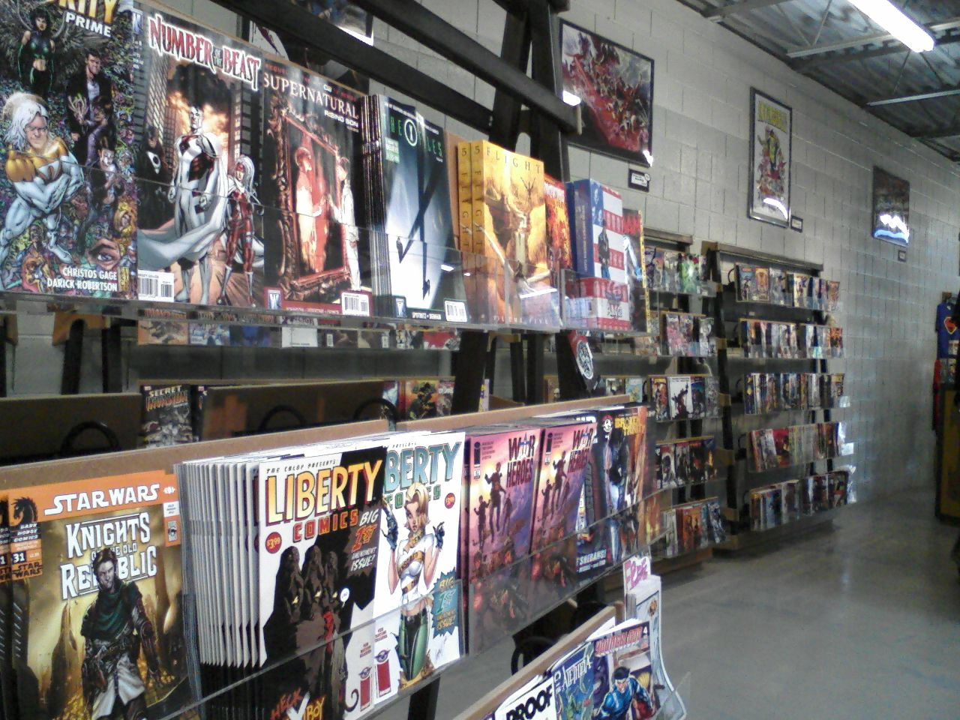
Phantom of the Attic Comics

Slide 12
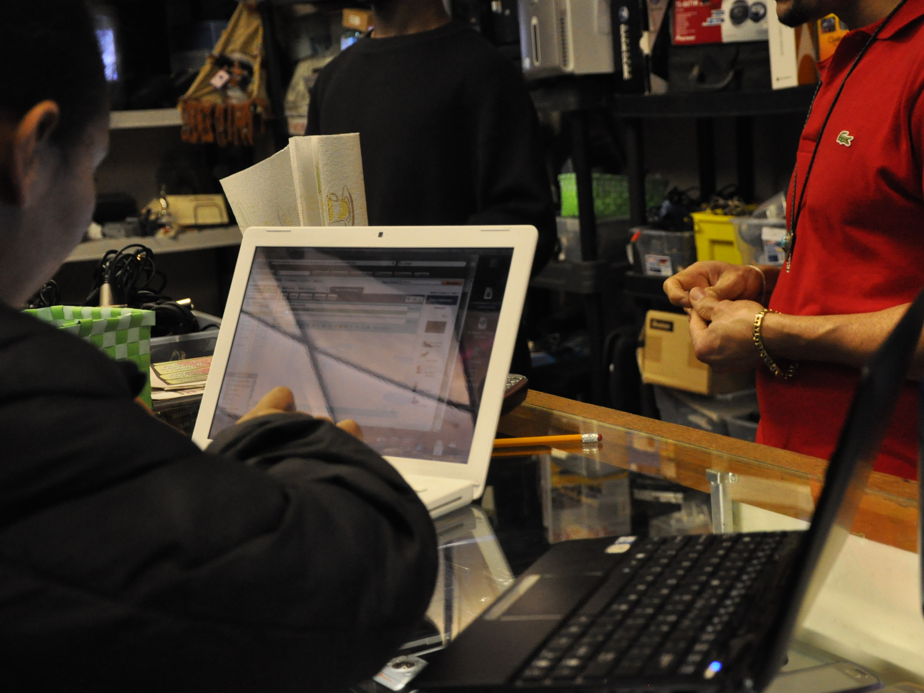
Pawn Shop

Slide 13
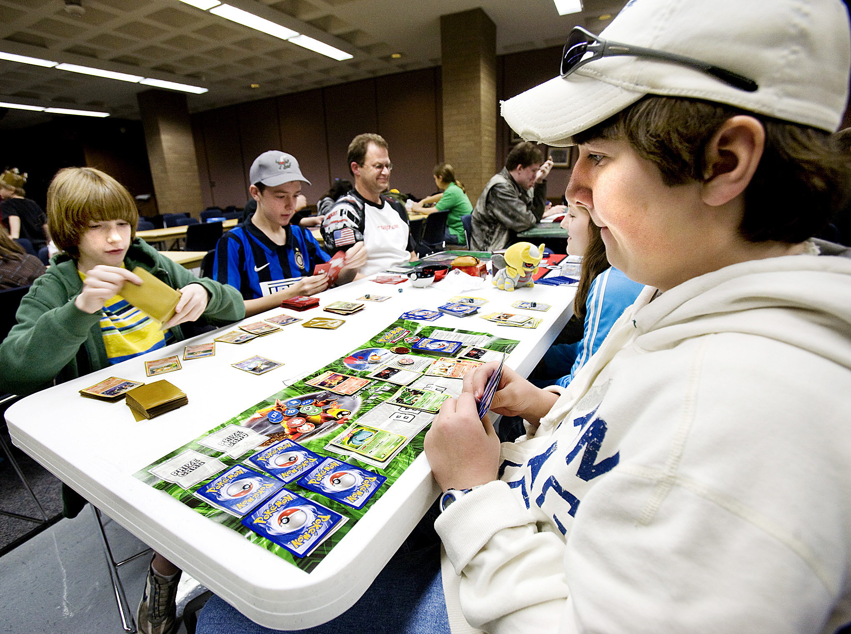
Pokemon Trading

Slide 14
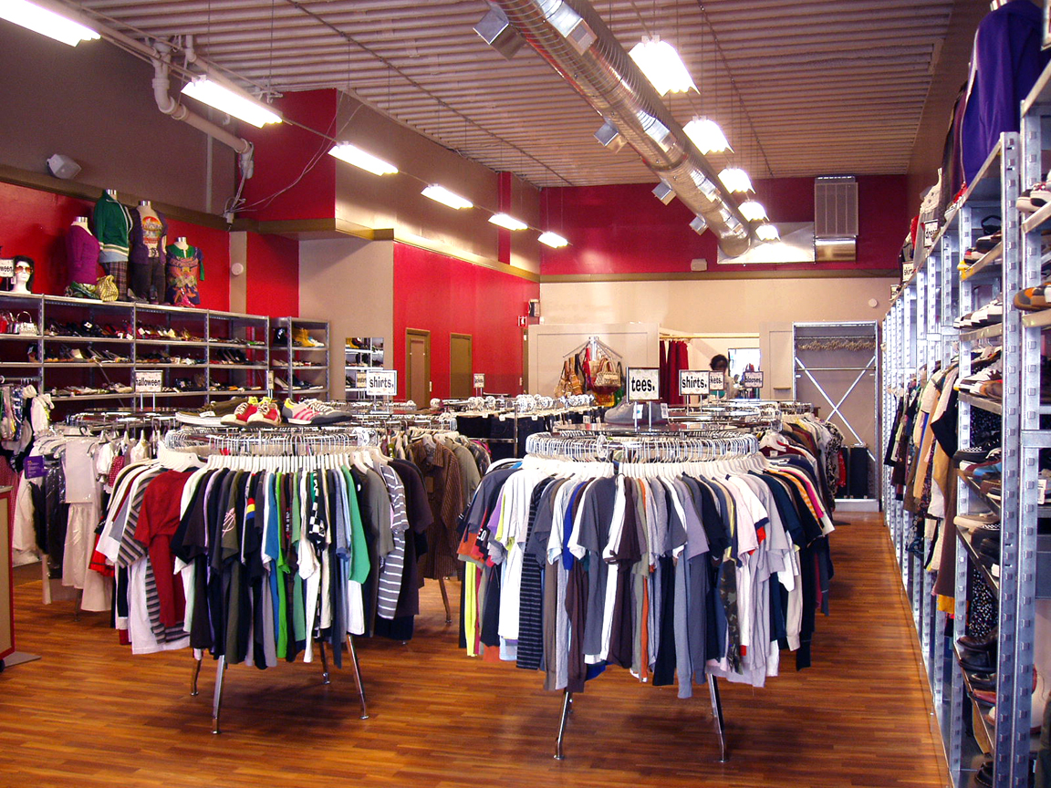
The Exchange

Slide 15
The Online Experience
Pros
Cons
Wider reach of people
Equal trading ground
Easier browsing
Faster trades
Community building
Easier to scam
Have to ship items
Harder to bargain

Slide 16
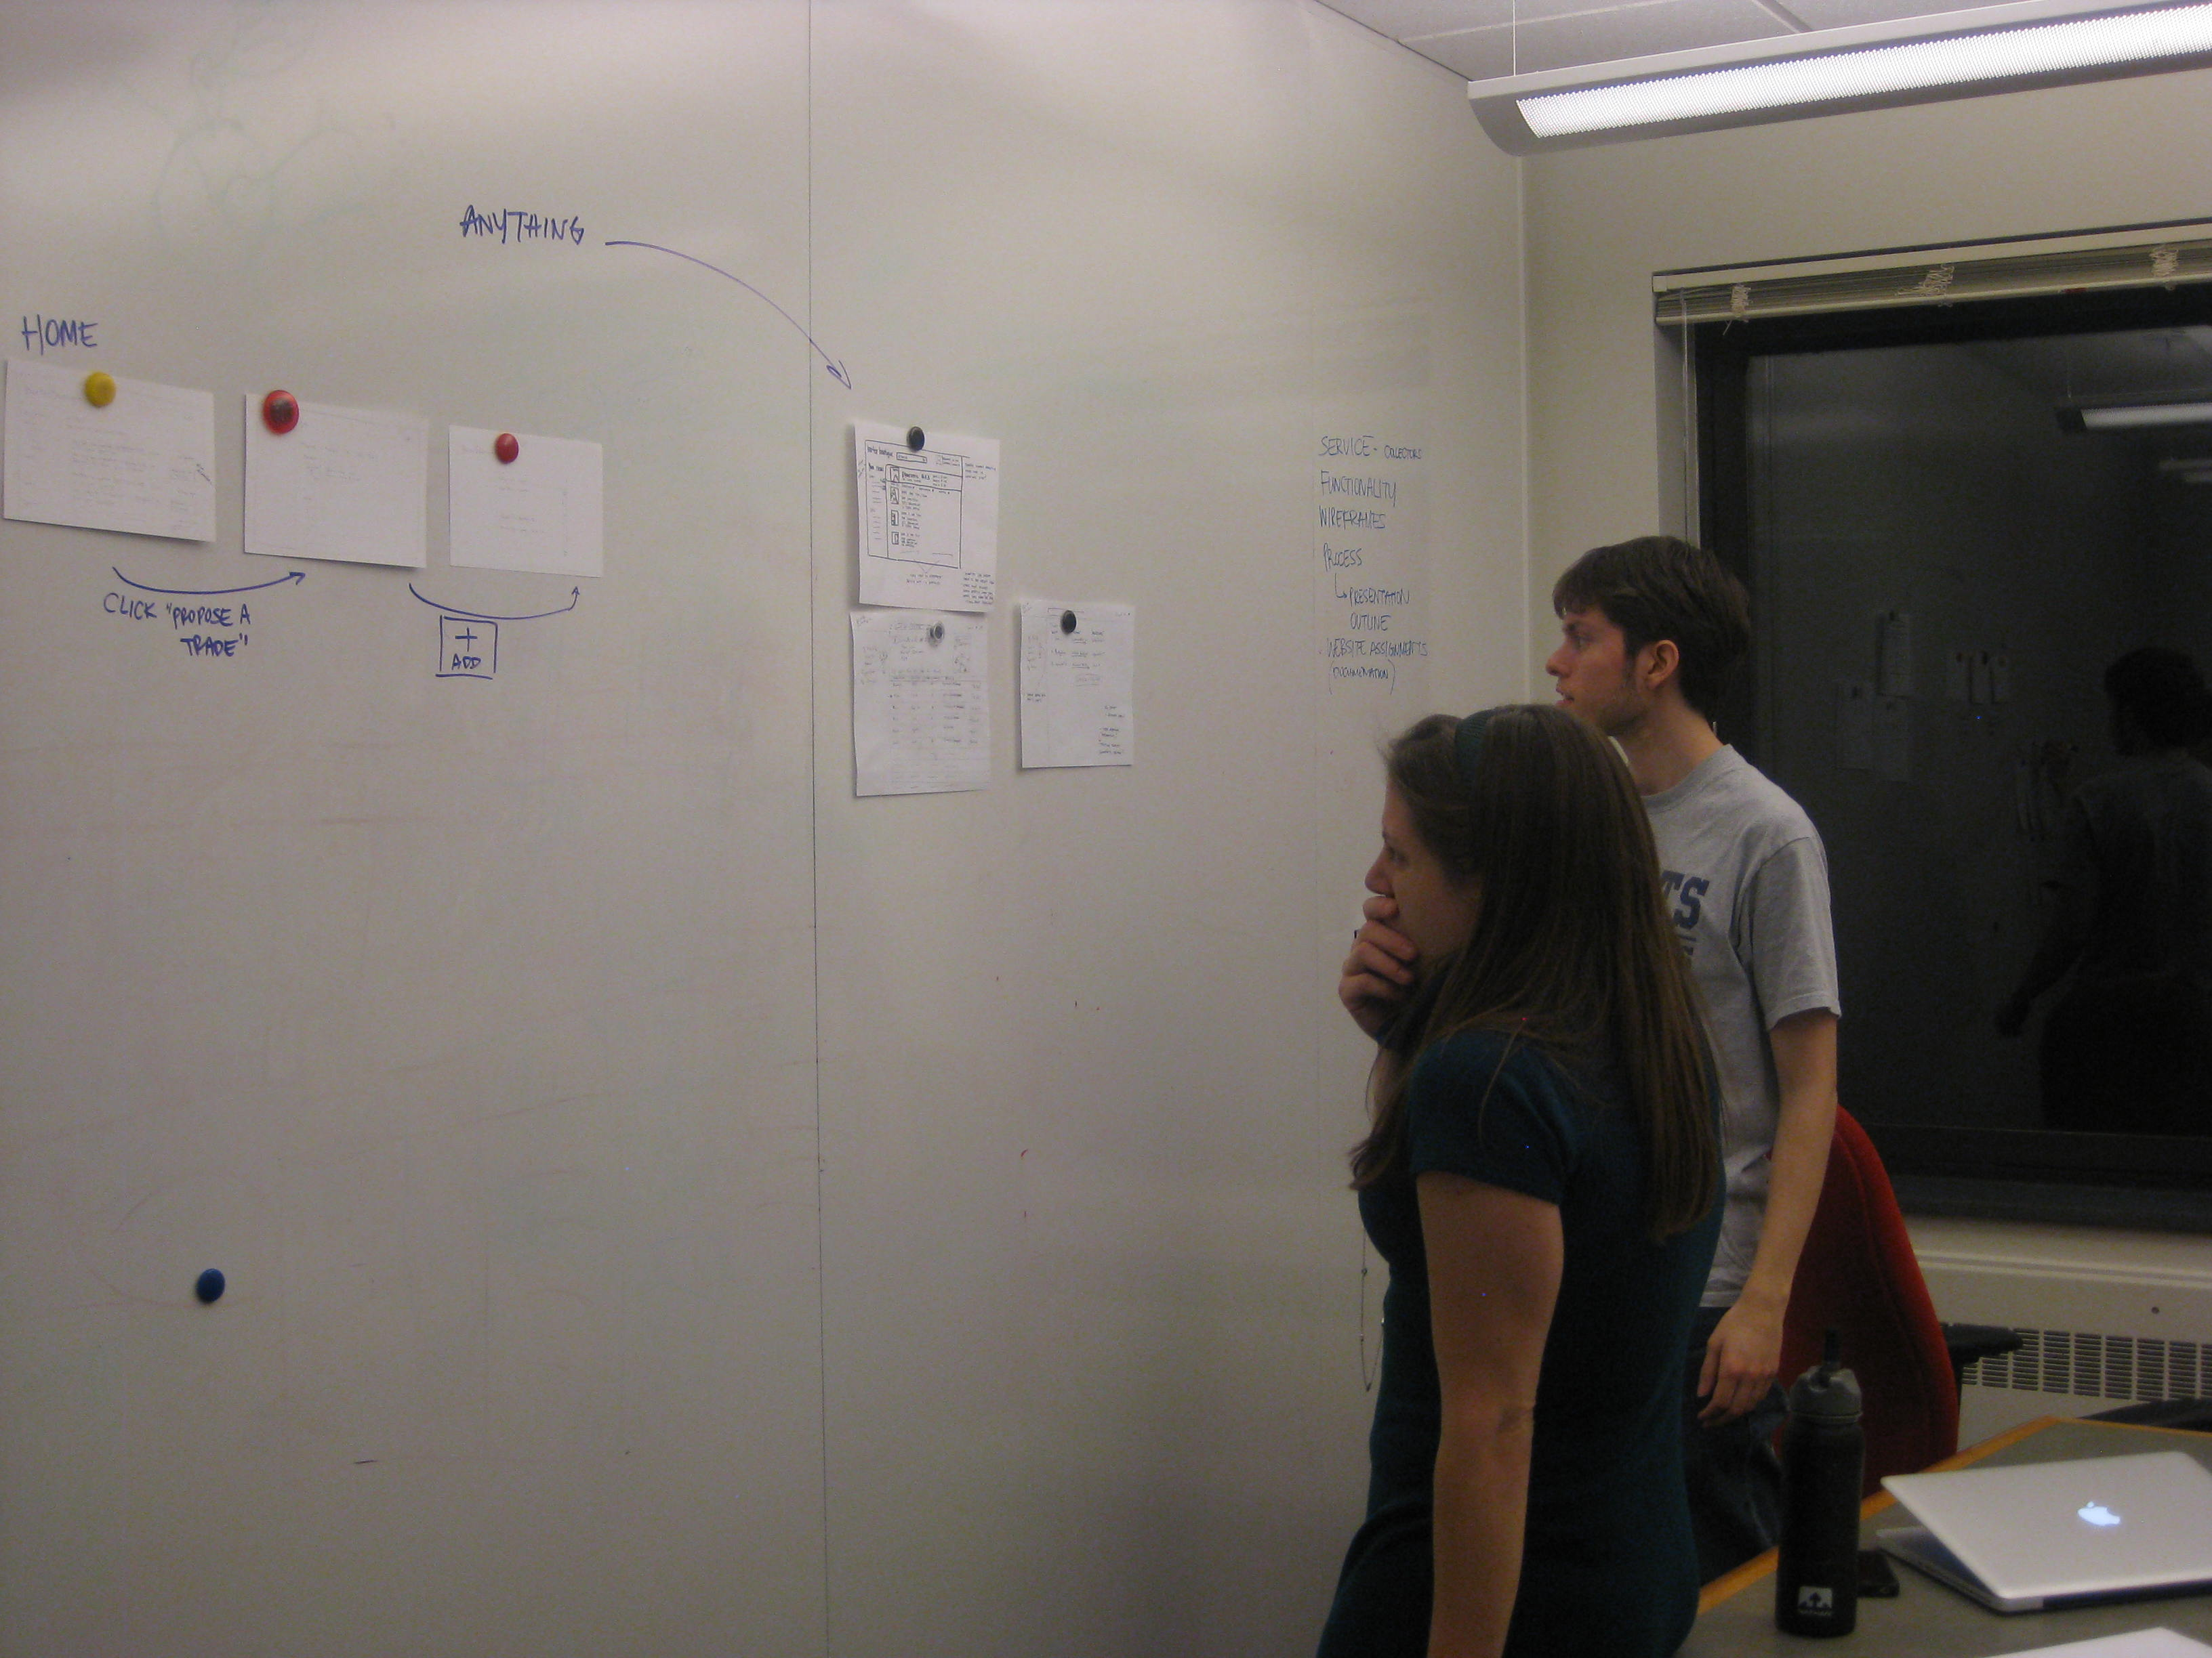
Synthesis

Slide 17
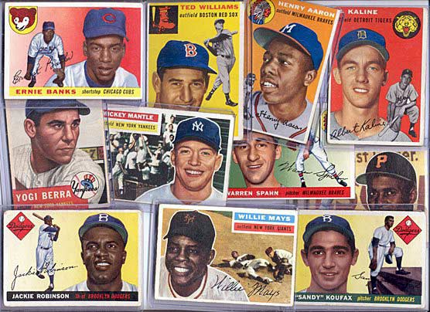
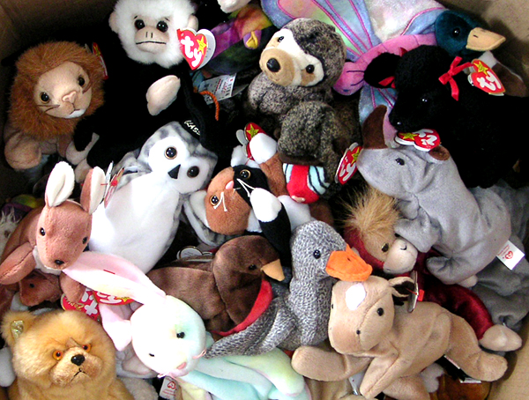
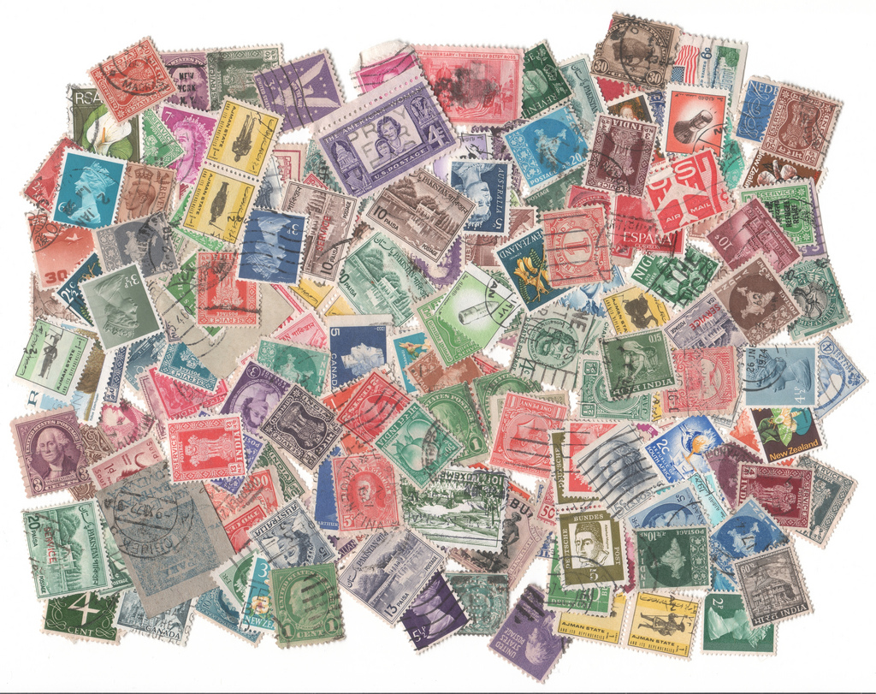
Target: Collectors
Several existing communities
Trade items regularly

Slide 18
Low Probability of Success
P
finding item
you want
P
having item
other wants
=
*
very low

Slide 19

Opportunities
Chains
Suggestions
itemX
itemY

Slide 20
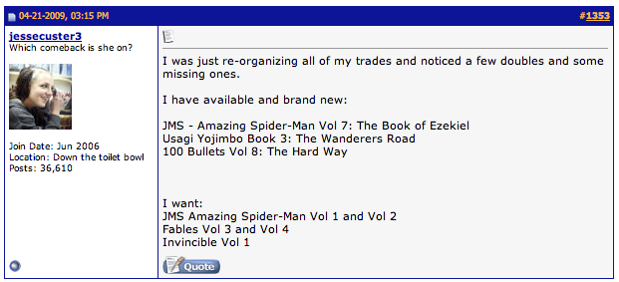
Current Collectible-Trading Sites

Slide 21
Current Collectible-Trading Sites

Slide 22
Opportunities
Allow users to search and list their wants and haves as separate
Pre-generated item pages
Consistent naming

Slide 23
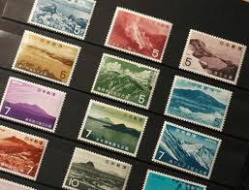
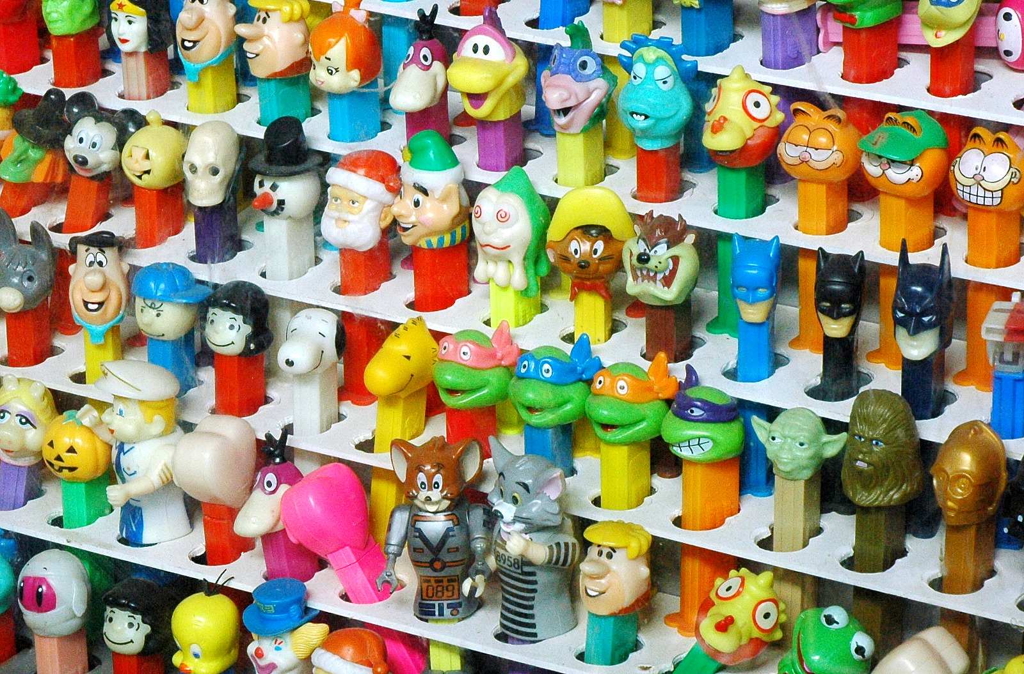
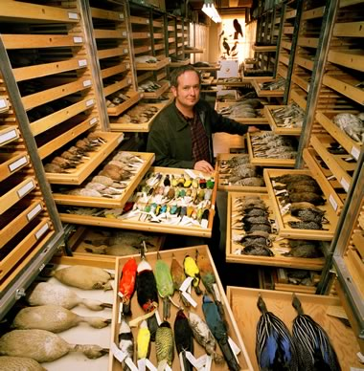
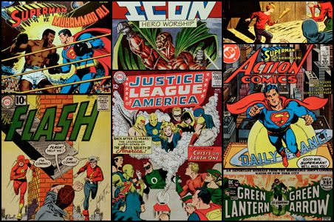
Mood Board

Slide 24
Personas

Slide 25

Dominic Ivanov, 26 (Novice)
Paralegal at Edgar Snyder in
Pittsburgh
Trades electronics, comics, and games with friends
Will trade at a store if it's more convenient
Does not recognize a "fair" deal
Goal is to complete Uncanny
X-men comic collection

Slide 26
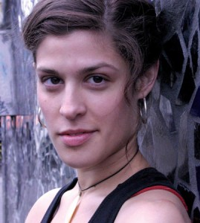
Sarah Hofstadter, 35 (Expert)
Lived in Pittsburgh for 16 years
Married for 5 years, no kids
Works at Phantom Comics with
her husband in Oakland
Attends Comic Cons
Hardcore comic collector
(Marvel only)
Goal is to build a strong
community of comic book
traders

Slide 27
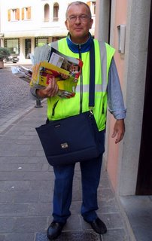
Ethan Jebediah Jones, 47
Born and raised in Indiana, PA
Single male, no children
Post office mail carrier for 20
years
Barters and trades to survive the failing economy
Hardcore Steelers fan
Collects and trades Steelers
memorabilia for fun

Slide 28
Comic Book Scenario

Slide 29
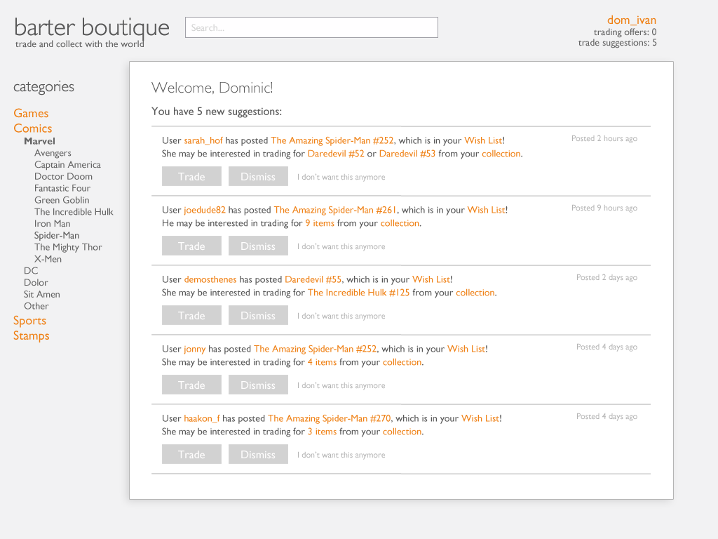

Slide 30
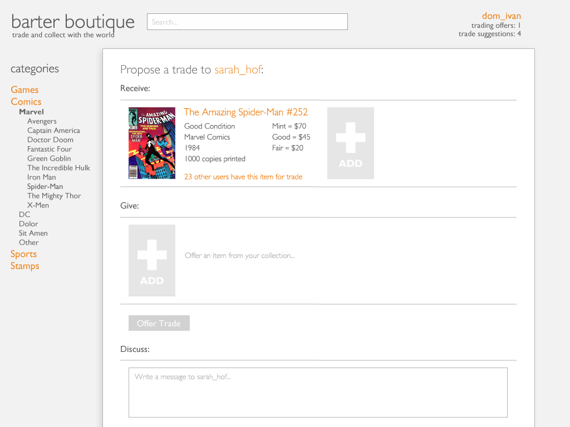

Slide 31
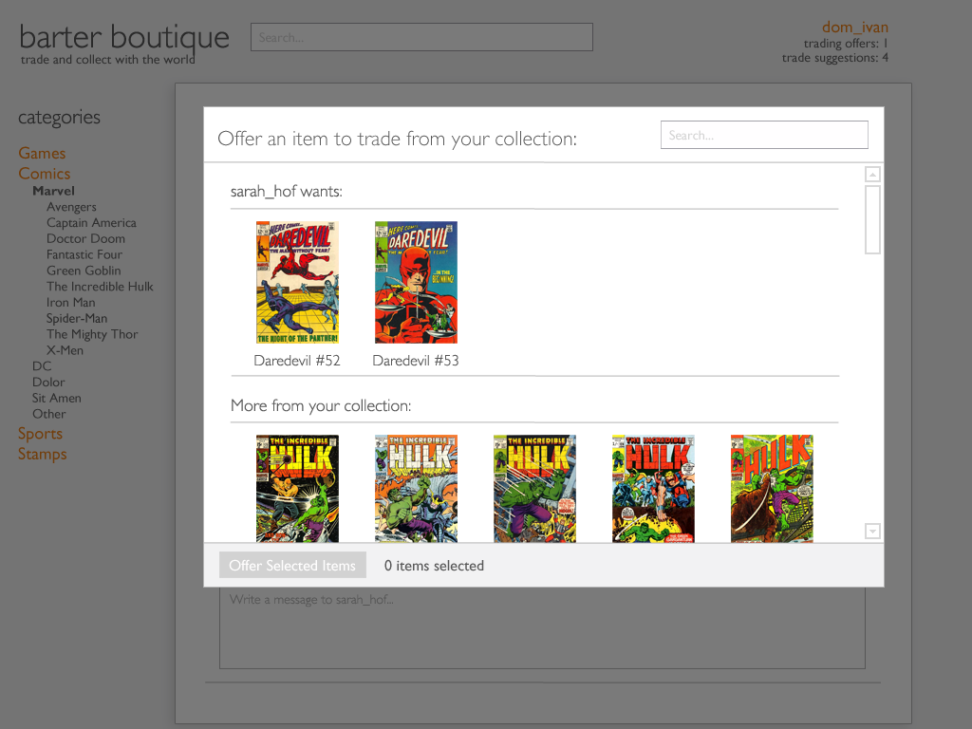

Slide 32
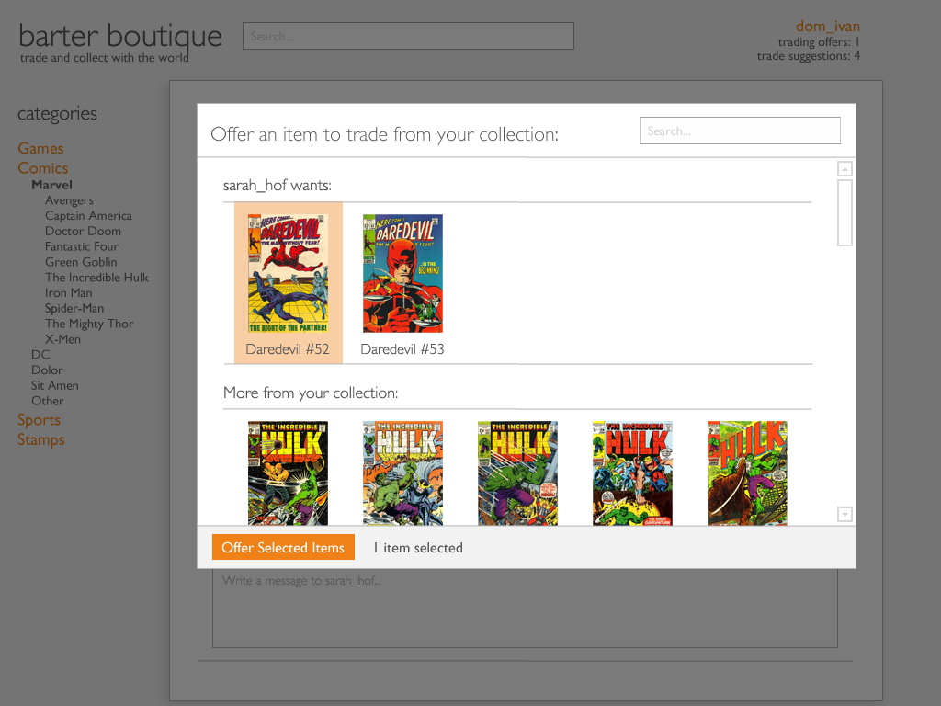

Slide 33
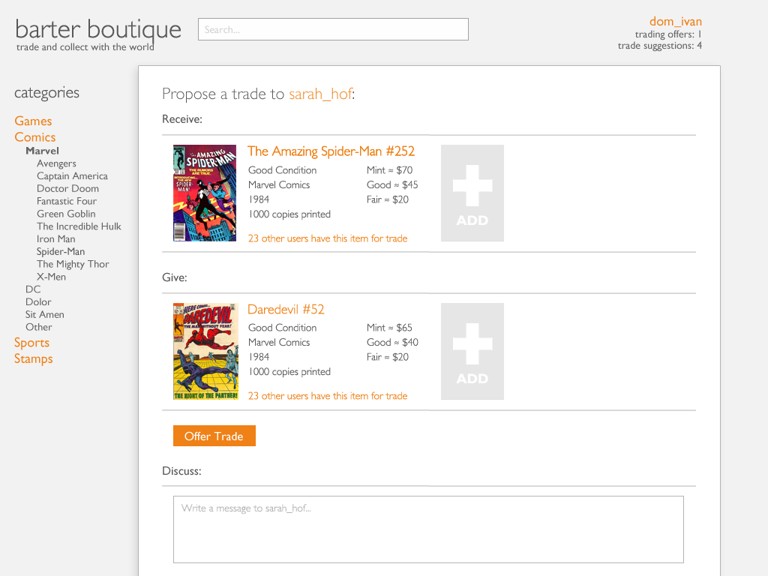

Slide 34
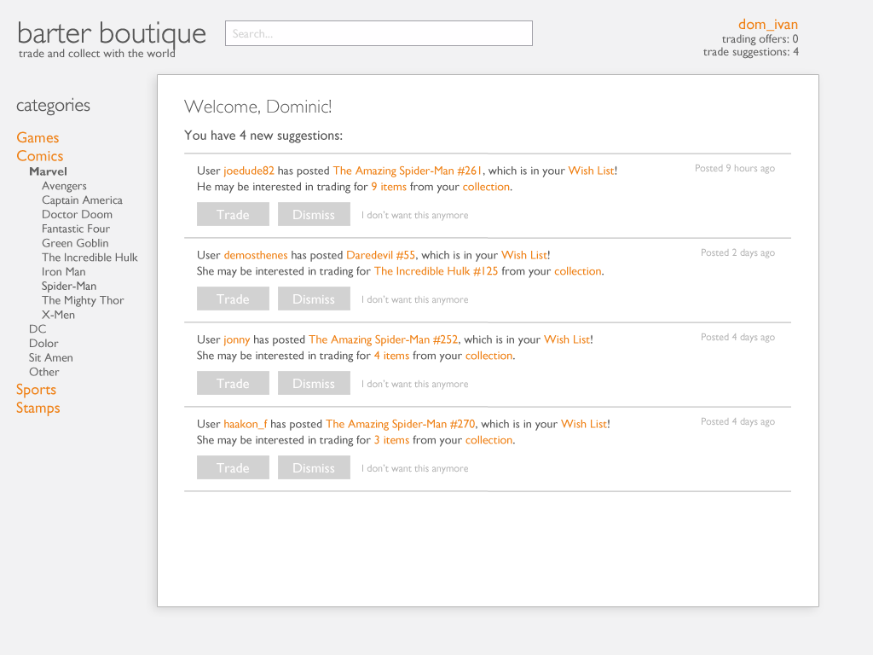

Slide 35
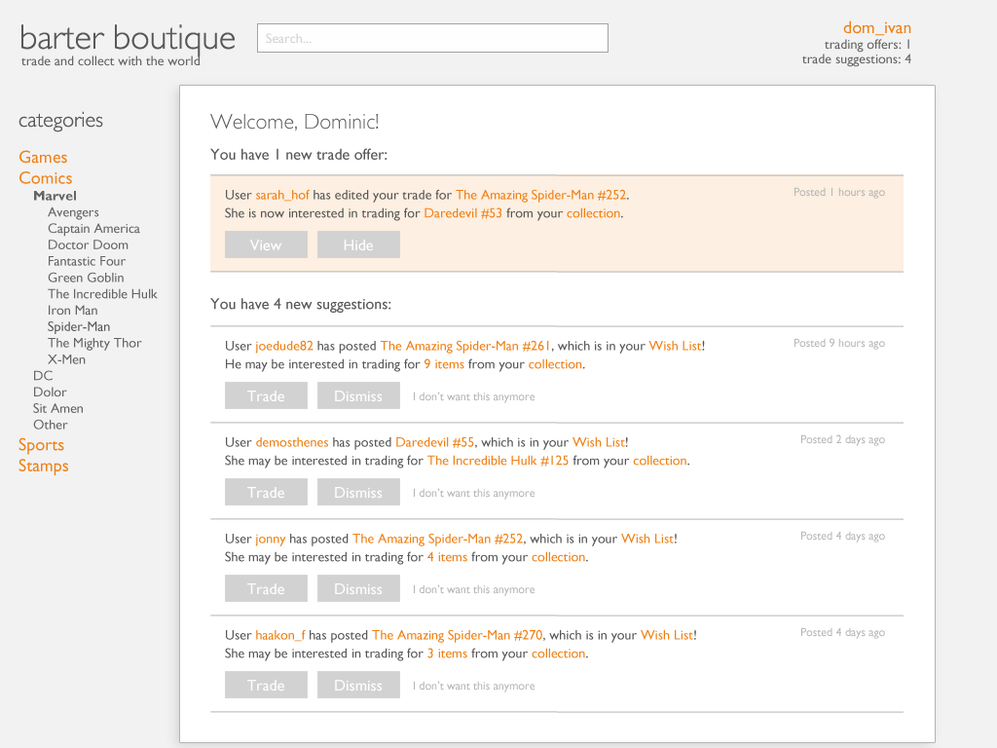

Slide 36
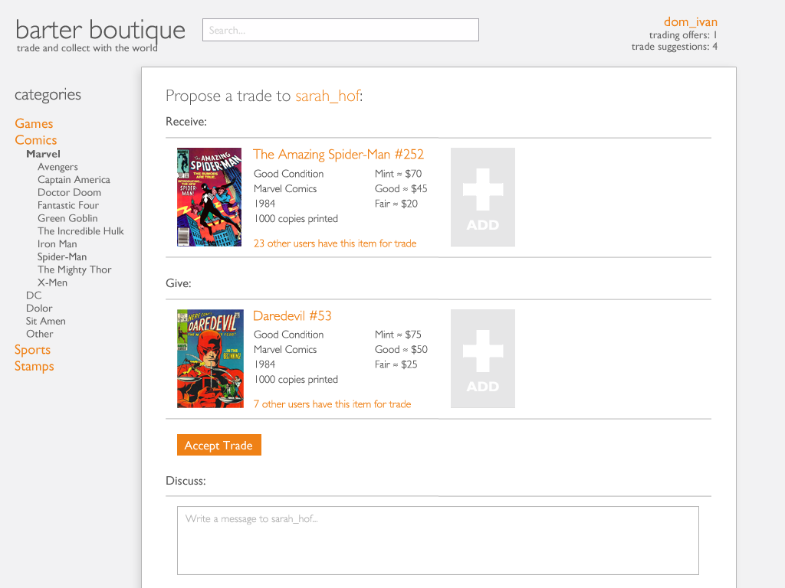

Slide 38
Steelers Memorabilia Scenario

Slide 39
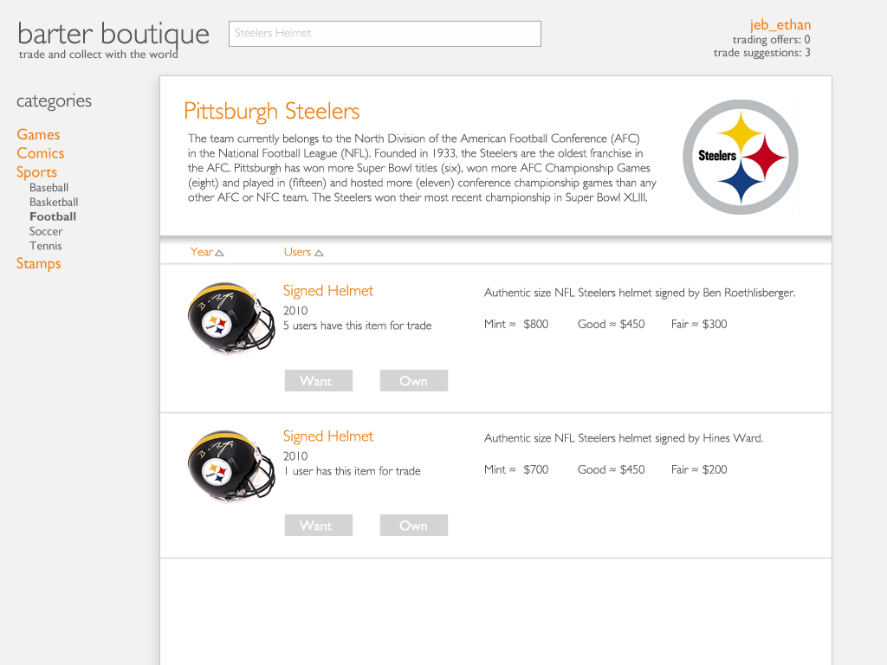

Slide 40
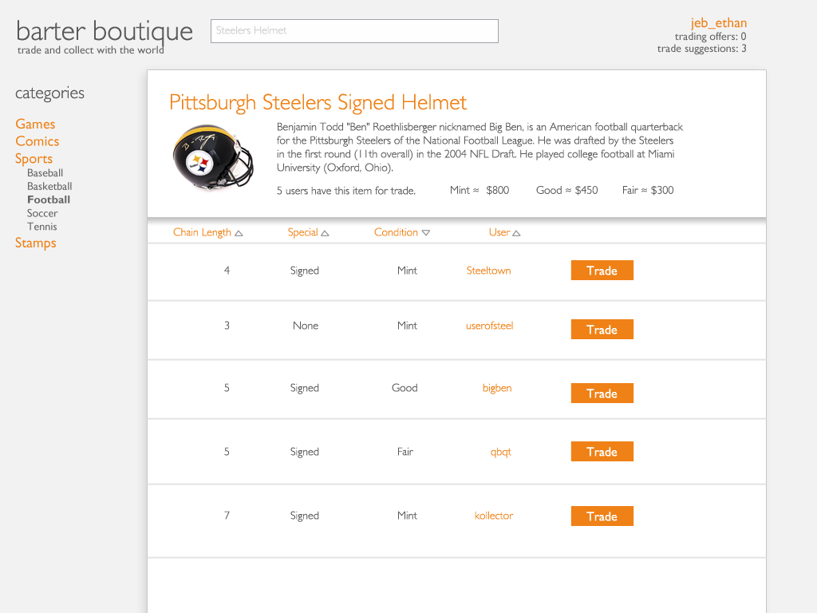

Slide 41
